Slide 1

Energy system modelling using OSeMOSYS
LECTURE 8
SOLAR AND WIND POWER PLANTS, OFF-GRID SOLUTIONS

Slide 2
Learning Outcomes
By the end of this lecture, you will be able to:
ILO1: Understand key characteristics of solar power plants, their environmental and social impacts, and how to represent them in OSeMOSYS
ILO2: Understand key characteristics of wind power plants, their environmental and social impacts, and how to represent them in OSeMOSYS
ILO3: Learn the difference between on-grid and off-grid technologies and their characteristics
2

Slide 3

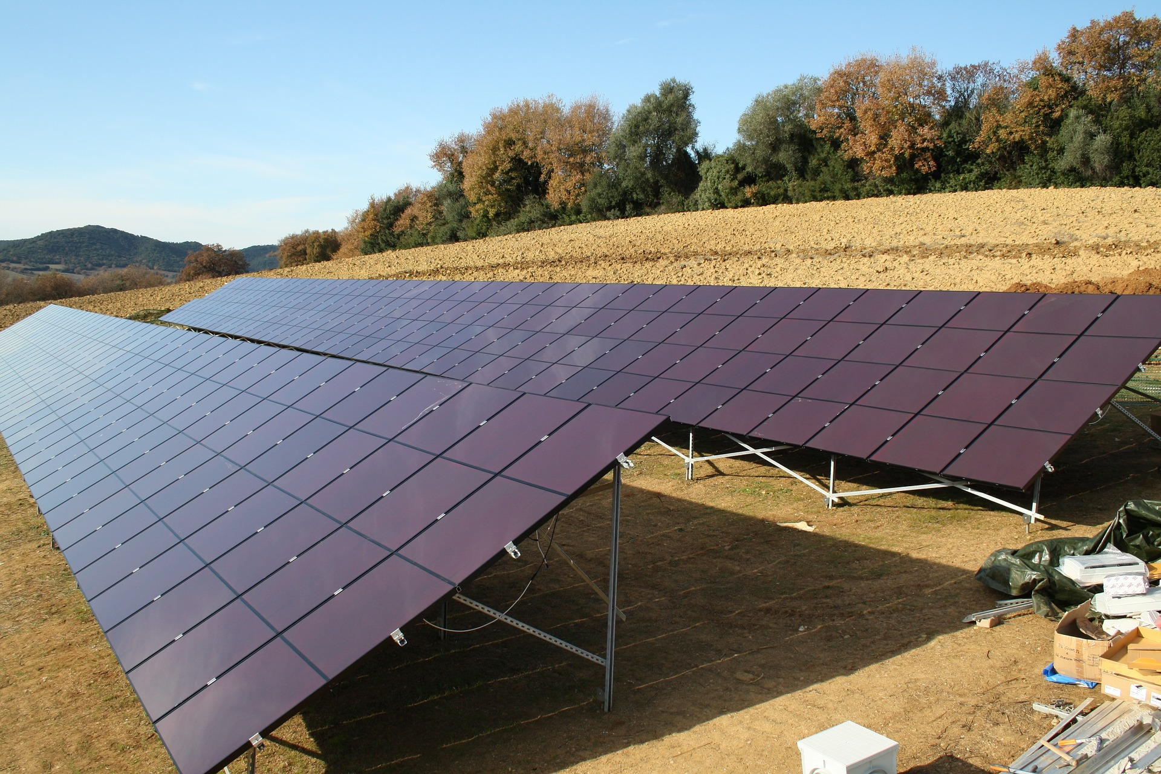
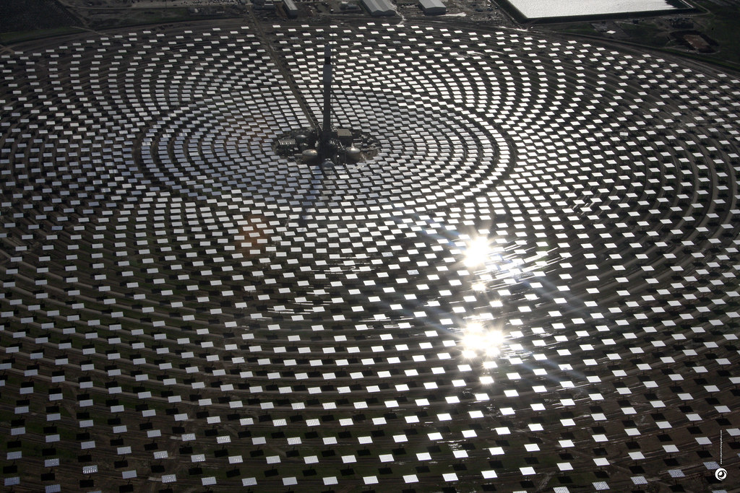
8.1 Solar Power Plants
8.1.1 Overview of Solar Power Plants
(Beyond Coal & Gas, image license: CC BY-NC 2.0)
(Concepts: Usher, W. (2021))
3
Notes:
There are two categories of solar power plants using different technologies to generate electricity: solar PV and solar thermal, also known as Concentrating Solar Power (or C.S.P.). This slide gives a brief overview of these technologies. C.S.P. systems use a set of solar collectors, which are like mirrors, to concentrate solar energy in order to create temperatures high enough to heat water and produce steam. This steam then drives a turbine to produce electricity. An example of a C.S.P. plant is shown in the image on the right of this slide, where mirrors are concentrating solar energy towards the tower in the centre. In contrast, solar PV technologies use photovoltaic panels to directly convert solar energy to electricity. This is done using a class of materials called semi conductors, with silicon being the most common. Of the two technologies, solar PV is currently the most common, and its use is growing rapidly as its costs continue to fall. The performance of solar technologies varies by location as this is dependent on weather characteristics.

Slide 4
8.1 Solar Power Plants
8.1.2 Environmental and Social Impacts of Solar Power Plants
Use of Toxic Materials
Resource Intensive
Changing Landscapes
Potentially High Water Use
Effects on Biodiversity
Environmental & Social Impacts of Solar Power Plants
(Concepts: Usher, W. (2021))
4
Notes:
This slide shows some of the potential environmental and social impacts of solar power plants. As we go through the course, we are learning that all technologies have their advantages and disadvantages and that it is important to appreciate these when using energy modelling tools. Whilst solar power plants have many pros, and can avoid some of the problems associated with other technologies, they do have potential impacts that we should be aware of. Firstly, solar PV technologies can use toxic materials and their manufacturing processes can require large amounts of water and mined metals. C.S.P. plants can also have high water consumptions, potentially at a similar level to comparably-sized coal or nuclear power plants, though this depends on the exact C. S. P. technology in use. As with most power plants, the installation of a solar PV or C.S.P. facility involves changing the landscape and can potentially create visual pollution, which may cause tension with local communities. These landscape changes can also affect local biodiversity. These potential impacts should all be considered when planning PV or C.S.P. projects.

Slide 5
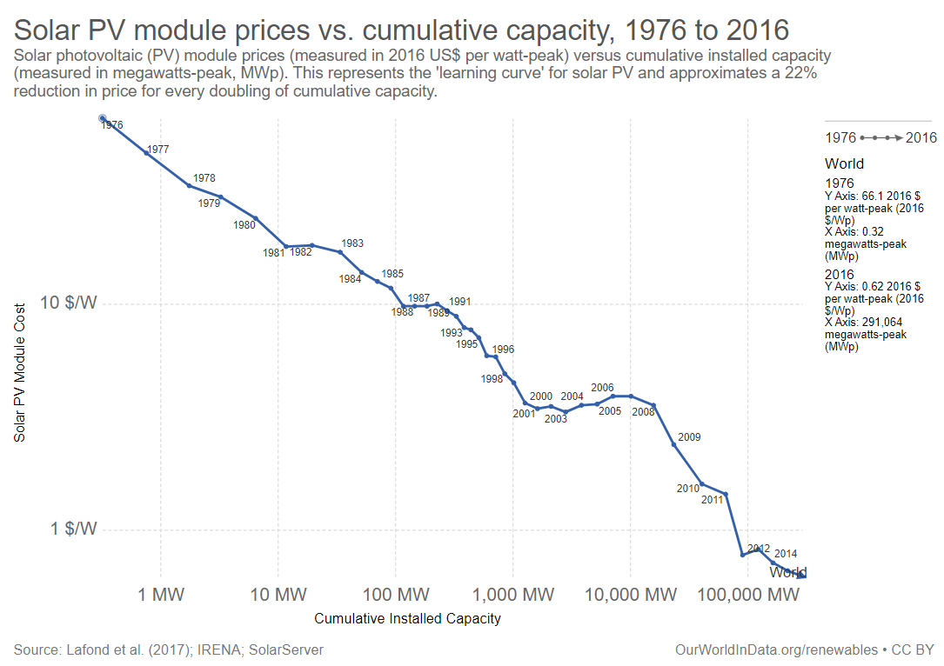
8.1 Solar Power Plants
8.1.3 Role of Solar Power Plants in Energy Systems
(Our World in Data, image, license: CC BY 3.0)
5
Notes:
In the last few years, there has been rapid growth in the installed capacity of solar PV plants globally. This trend is shown on this diagram, which also shows the rapid decline in the costs of solar PV in recent years. Solar PV has become increasingly affordable, reaching grid parity in countries with good solar resources. These cost reductions are forecast to continue, further increasing the potential role for PV in energy systems. A key advantage of solar technologies is that they are a source of renewable energy generation and do not create combustion-related carbon dioxide emissions. This, combined with the increasing affordability of solar PV, means PV could be a key technology for reducing the carbon intensity of energy systems. C.S.P. technologies are yet to undergo the cost reductions seen in solar PV. When talking about solar technologies, a key thing to remember is that they are forms of variable and intermittent renewable energy generation. This means that the amount of electricity they can generate varies as the weather changes. For example, a solar PV panel could not generate electricity in the dark, but could in the middle of the day. This is a key difference compared to the forms of fossil fuel generation discussed in lecture 6. However, the variable and intermittent nature of these technologies does not mean that they cannot play a significant role in our energy systems. For example, non-variable renewable energy sources, such as geothermal power plants, could be used to ensure necessary stability of the grid while increasing shares of economically favourable solar PV and reducing reliance on fossil fuels. Additionally, solar technologies can be paired with battery storage to increase their flexibility.

Slide 6
8.1 Solar Power Plants
8.1.4 Solar Power Plants in OSeMOSYS Pt1
Example PV power plant data for key OSeMOSYS parameters:
Capacity Factor: varies by country and timeslice
Capital Cost: $2000/kW
Fixed Cost: $24/kW
Operational Life: 25 years
Example CSP plant data for key OSeMOSYS parameters:
Capacity Factor: varies by country and timeslice
Capital Cost: $5050/kW
Fixed Cost: $200/kW
Operational Life: 25 years
(Data source: Pappis et al. (2019) Energy Projections for African Countries)
6
Notes:
This slide shows example data for some key OSeMOSYS parameters, this time for both solar PV and C.S.P. We can see that the capacity factor varies significantly by country for both technologies; this is because the capacity factor is strongly dependent on the intensity of the sunlight in the country as well as the distribution of sunlight throughout the day and each season. Furthermore, capacity also varies based on timeslice as the solar intensity ranges based on the time of day and year. Therefore, it is incredibly important to capture this temporal variability in solar technologies capacity factors by having timeslices with different values that account for this. It is hard to define a range for capacity factors for PV and C.S.P. as they are so country-dependent; however, you might expect the capacity factor for PV to be between approximately 0.1 to 0.3 and for C.S.P. to be between approximately 0.2 to 0.5. We will practise adding solar capacity factors to a model in the hands-on exercises. Moving to costs, we can see that currently solar PV technologies have significantly lower costs than C.S.P., as discussed previously. The operational life of both technologies is approximately 25 years.

Slide 7
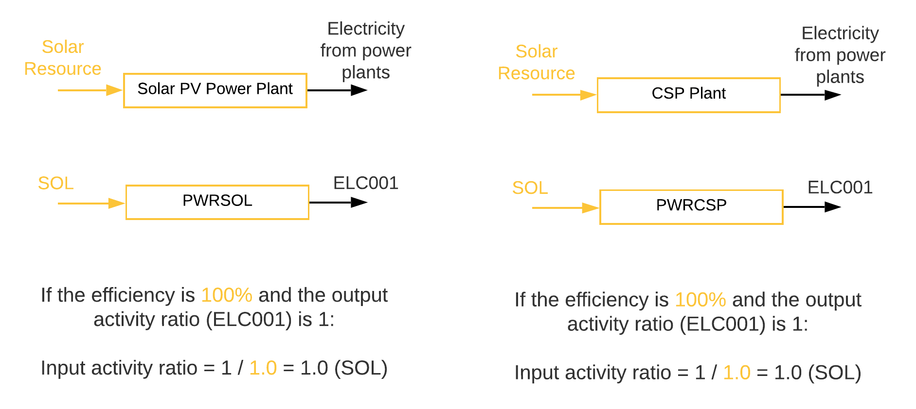
8.1 Solar Power Plants
8.1.5 Solar Power Plants in OSeMOSYS Pt2
7
Notes:
Again, as in lecture 6, we will now look at how solar power plant technologies are represented in Reference Energy Systems and calculate example input and output activity ratios. We can see here that both PV and C.S.P. power plants are modelled as a technology with the input fuel being the solar resource and the output fuel being electricity. We can also see the generic code names used for these technologies and fuels. As with hydropower, solar power plant technologies are modelled with 100% efficiency in OSeMOSYS. We will also define the output activity ratio to be 1 as in our previous examples, and it will be assigned to E.L.C. 0 0 1 since this is the output fuel. The input activity ratio is then determined by calculating 1, divided by the efficiency as a decimal, which in this case is 1 divided by 1. This gives an input activity ratio of 1.0 for both PV and C.S.P. technologies. The input activity ratio will be assigned to S.O.L., since this is the input fuel for both technologies. Disclaimer: Similar to geothermal and hydropower you do not necessarily need an input solar resource for solar technologies because the resource does not affect the economics like fossil fuels do for fossil fuel plants. It is only useful to have an input commodity when we want to limit the expansion and we have more than one technology using a specific resource. Otherwise you can simply have solar technologies directly producing electricity with no input commodity.

Slide 8
Lecture 8.1 References
Usher, William. (2021, March). Wind, solar and biofuels: social, environmental and economic concerns (Version 1). Zenodo. http://doi.org/10.5281/zenodo.4585632
Pappis, I., Howells, M., Sridharan, V., Usher, W., Shivakumar, A., Gardumi, F. and Ramos, E., Energy projections for African countries, Hidalgo Gonzalez, I., Medarac, H., Gonzalez Sanchez, M. and Kougias, I., editor(s), EUR 29904 EN, Publications Office of the European Union, Luxembourg, 2019, ISBN 978-92-76-12391-0, doi:10.2760/678700, JRC118432.
8

Slide 9

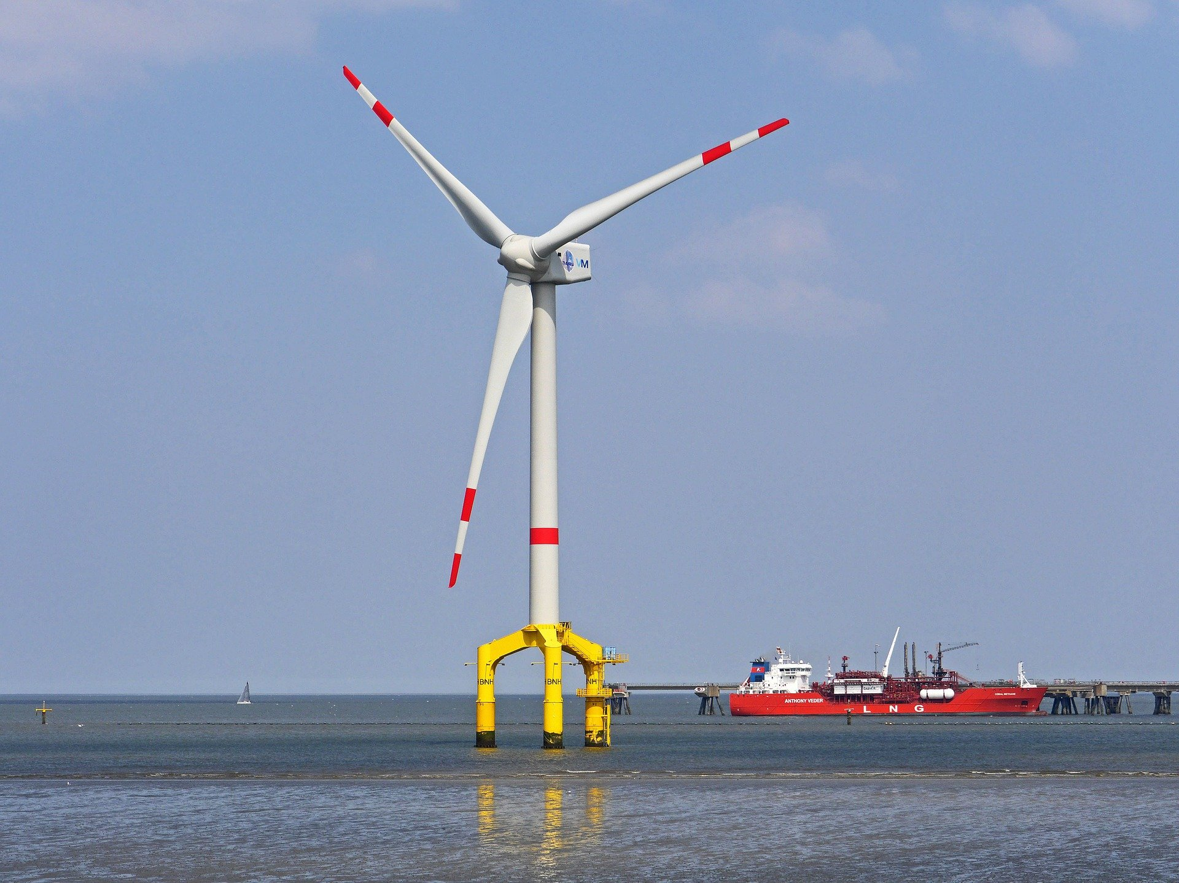
8.2 Wind Power Plants
8.2.1 Overview of Wind Power Plants
9
Notes:
We will now move on to a brief overview of wind power plant technologies. There are two main types of wind power plant: onshore and offshore. Both of these are based around the same turbine technologies and electricity generation process, just with different designs of turbine to suit offshore environments. Offshore turbines can also typically be larger than onshore turbines. Natural winds blow the blades of the wind turbine, causing them to rotate and driving an electrical generator within the turbine to produce electricity. The performance of wind turbines varies by location, as it is dependent on the local wind conditions. Typically wind speeds are higher offshore and so offshore wind farms often produce more electricity and have higher capacity factors.

Slide 10
8.2 Wind Power Plants
8.2.2 Overview of Wind Power Plants
Local Habitat Damage
Landscape Fragmentation
Impacts on Bird Migration
Visual perception
Noise
Environmental & Social Impacts of Wind Power Plants
(Concepts: Usher, W. (2021))
10
Notes:
Wind power plants can have an important role in energy systems and offer several advantages which we will explore in the next slide. Firstly, however, we should consider potential environmental and social impacts as we have done for other technologies. Environmentally, the main possible concerns with wind power plants are damage to local habitats, fragmentation of landscapes, and impacts on the migratory patterns of local birds. For these reasons, it is important to thoroughly assess the potential impacts on local habitats and wildlife when planning wind projects. On the social side, local people can sometimes be opposed to wind power projects due to the way they look and the noise they can create.

Slide 11
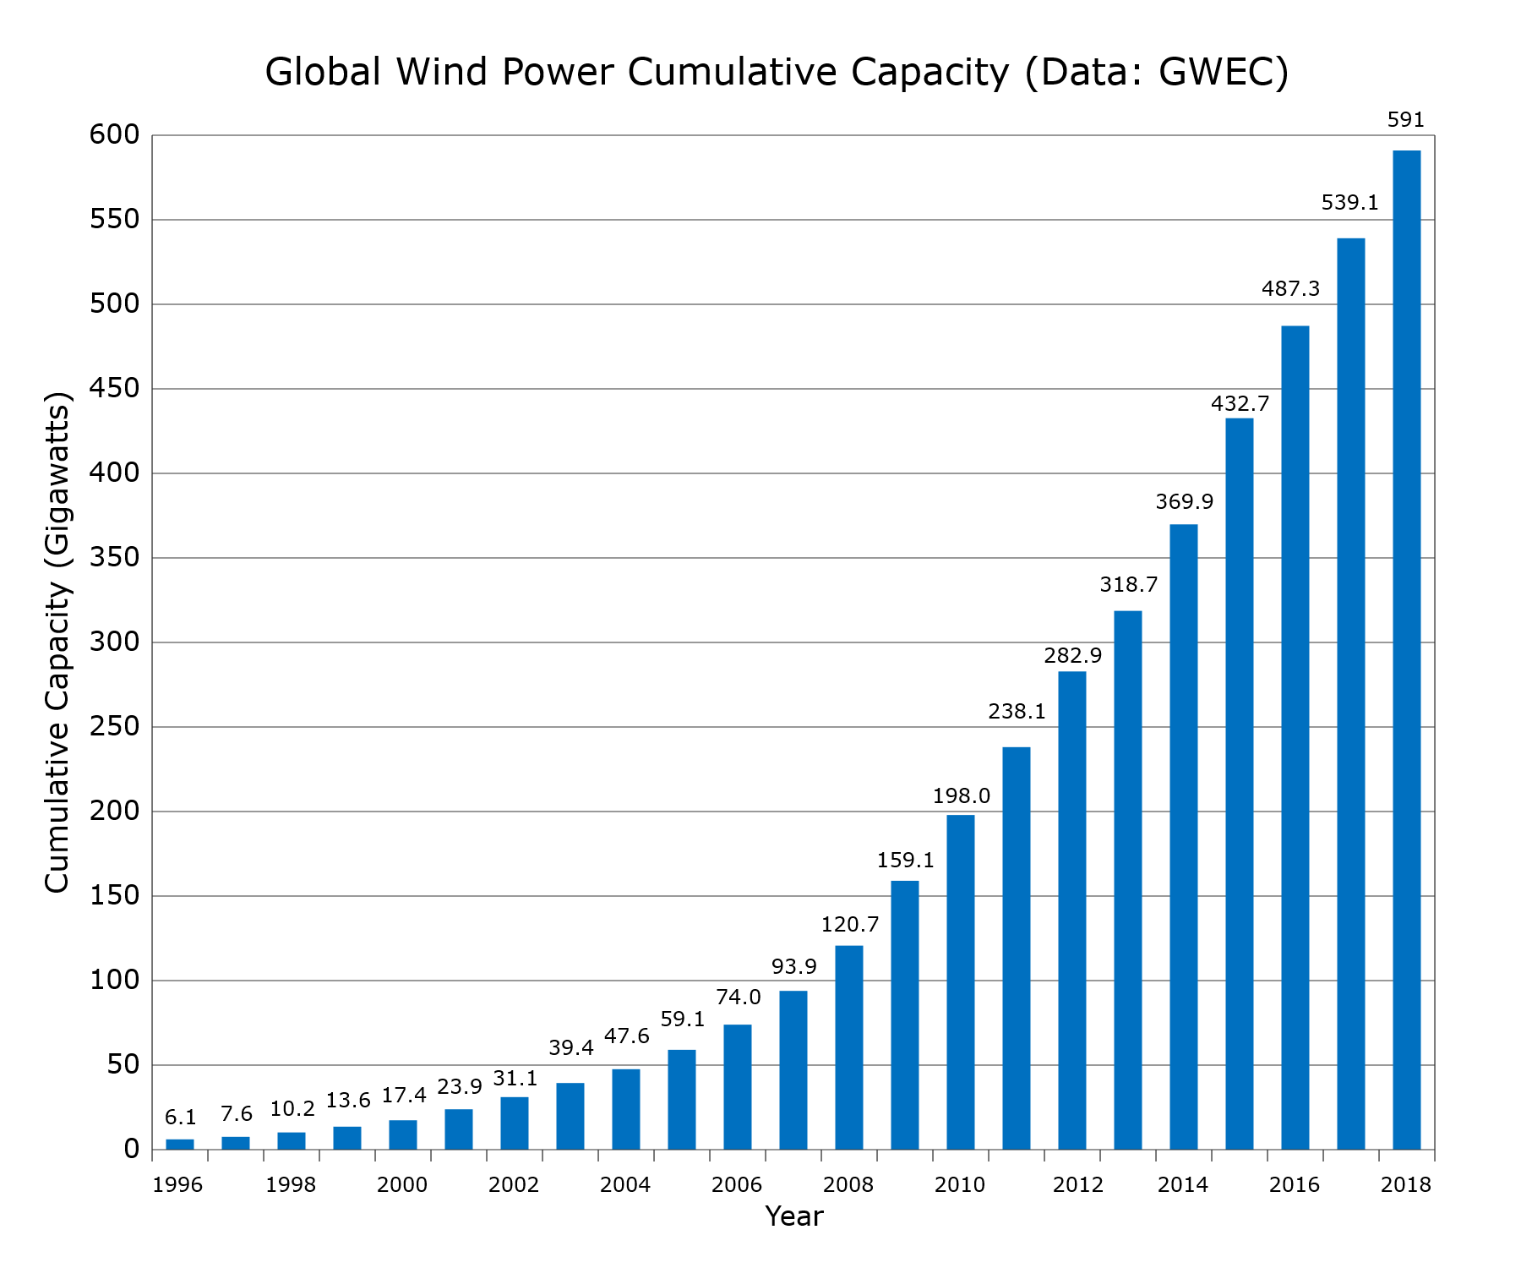
8.2 Wind Power Plants
8.2.3 Role of Wind Power Plants in Energy Systems
11
Notes:
This diagram shows the rapid increase in global wind power capacity in the last 20 years, with the total capacity in 2018 over 590 GW. Wind power can play an important role in decarbonizing energy systems since, similarly to solar technologies, it is not associated with the combustion-related carbon dioxide emissions of fossil power plants. Wind power deployment could therefore help to reduce reliance on finite and polluting fossil fuels. Wind power is also becoming increasingly cost-effective and, like other renewables, can help to increase energy security by reducing reliance on imported fuels. However, there are some key points to consider when thinking about wind power's role in energy systems. Firsly, like solar technologies, wind power is a form of variable and intermittent renewable energy generation. This means that wind power plants have variable output depending on the weather conditions and so cannot be relied upon as much as fossil power plants or non-variable renewables like geothermal power. The impact of this variability on the wider energy system can be reduced through the use of battery storage to increase flexibility, or the use of flexible power plants, such as gas or biomass, alongside wind. We can see that it is very important to consider the electricity system as a whole when planning capacity expansion, because all technologies have advantages and disadvantages, and there is no single best option. It is likely that a combination of technologies will be needed to meet climate targets whilst also ensuring economic viability and system reliability.

Slide 12
8.2 Wind Power Plants
8.2.4 Wind Power Plants in OSeMOSYS Pt1
Example onshore wind power plant data for key OSeMOSYS parameters:
Capacity Factor: varies by country and timeslice
Capital Cost: $1880/kW
Fixed Cost: $48/kW
Operational Life: 25 years
Example offshore wind power plant data for key OSeMOSYS parameters:
Capacity Factor: varies by country and timeslice
Capital Cost: $4700/kW
Fixed Cost: $165/kW
Operational Life: 25 years
(Data source: Pappis et al. (2019) Energy Projections for African Countries)
12
Notes:
As for solar technologies, this slide shows example data for some key OSeMOSYS parameters for onshore and offshore wind power plants. We can see that, again, the capacity factor for both of these technologies varies significantly by country. This is because the capacity factor is dependent on local wind conditions. We typically expect that the capacity factor would be higher for offshore wind due to the greater windspeeds. For example, an estimated offshore capacity factor might be around 0.45, while for onshore wind this might be around 0.3. As with solar technologies, the capacity factors for wind technologies will typically vary across different time slices in an energy model. Therefore, it is incredibly important to incorporate this temporal variability in wind technologies by having varying capacity factor values for each timeslice. We will practise adding wind capacity factors in hands-on exercises. Moving to costs, we can see that offshore wind is significantly more cost-intensive than onshore wind. This is because more complex equipment is needed to build, maintain, and operate turbines offshore, which need to withstand harsh weather conditions. We can see that onshore wind costs are competitive with those of other power generation technologies we have learnt about. An estimated operational life for both onshore and offshore wind power plants is 25 years.

Slide 13
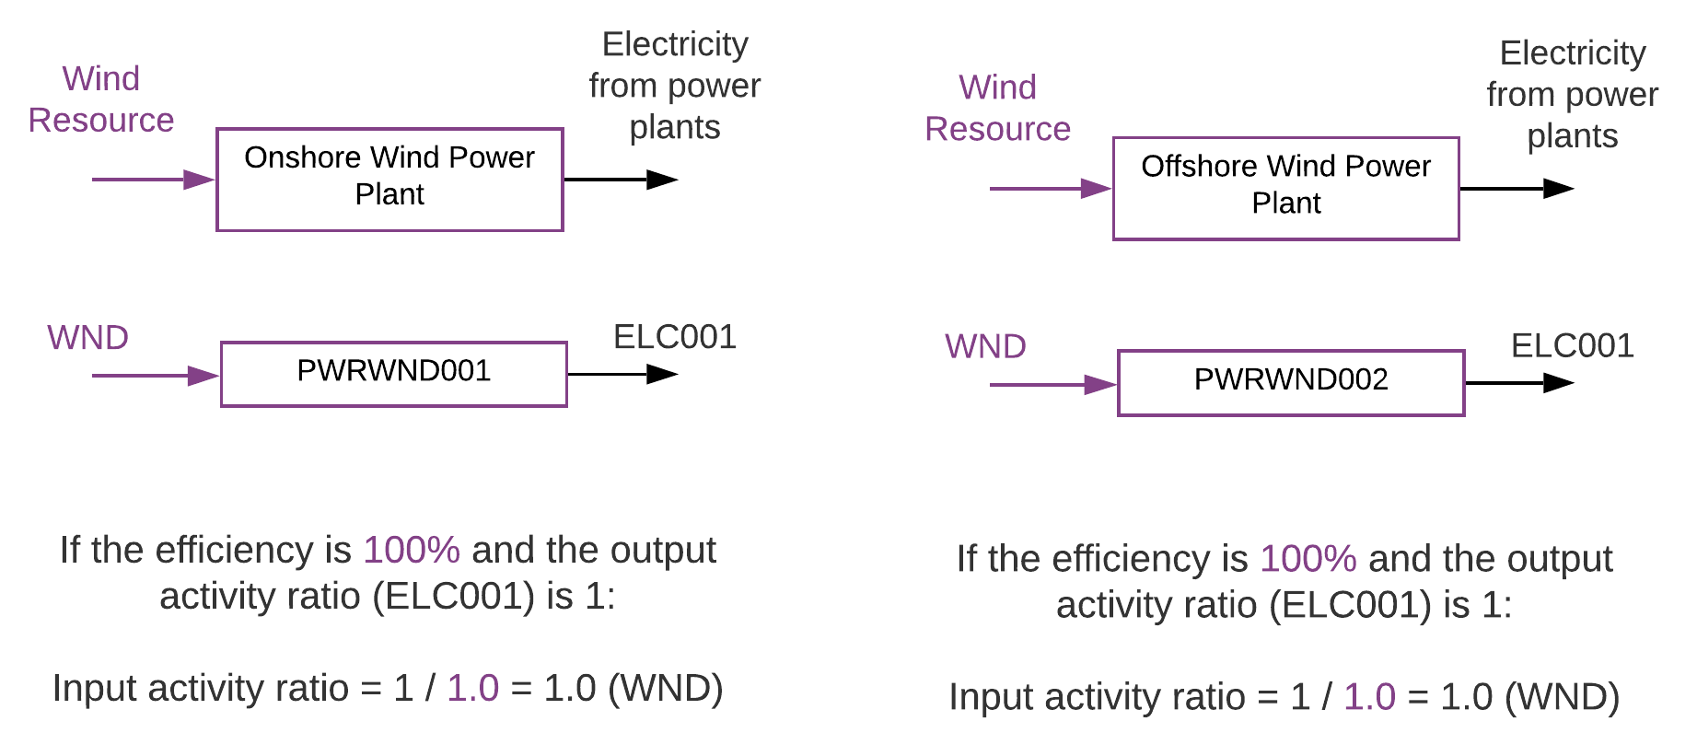
8.2 Wind Power Plants
8.2.5 Wind Power Plants in OSeMOSYS Pt2
13
Notes:
Finally, this diagram shows how onshore and offshore wind power plants are represented in Reference Energy Systems, as for the other power generation technologies we have looked at. Both onshore and offshore wind power plants are seen as a technology with an input fuel of the wind resource and an output fuel of electricity. We can also see the code names used for these technologies and fuels – notice that we distinguish between onshore and offshore wind using a number at the end of the technology code name. Finally, let's work through an example of calculating the input activity ratio for wind power plants. As we have done previously, we will set the output activity ratio to 1 and assign it to E.L.C. 0 0 1 since this is the output fuel. Remember that if the output activity ratio is 1, the input activity ratio can be determined by calculating 1 divided by the efficiency as a decimal. As with solar technologies, wind technologies are modelled in OSeMOSYS with 100% efficiency, so the input activity ratio here would be equal to 1 divided by 1, giving a value of 1. The input activity ratio will be assigned to W.N.D. since this is the input fuel for our wind technologies. Disclaimer: Similar to geothermal, hydropower, and solar technologies you do not necessarily need an input wind resource for wind technologies because the resource does not affect the economics like fossil fuels do for fossil fuel plants. It is only useful to have an input commodity when we want to limit the expansion and we have more than one technology using a specific resource. Otherwise you can simply have wind technologies directly producing electricity with no input commodity.

Slide 14
Lecture 8.2 References
Usher, William. (2021, March). Wind, solar and biofuels: social, environmental and economic concerns (Version 1). Zenodo. http://doi.org/10.5281/zenodo.4585632
Pappis, I., Howells, M., Sridharan, V., Usher, W., Shivakumar, A., Gardumi, F. and Ramos, E., Energy projections for African countries, Hidalgo Gonzalez, I., Medarac, H., Gonzalez Sanchez, M. and Kougias, I., editor(s), EUR 29904 EN, Publications Office of the European Union, Luxembourg, 2019, ISBN 978-92-76-12391-0, doi:10.2760/678700, JRC118432.
14
14

Slide 15
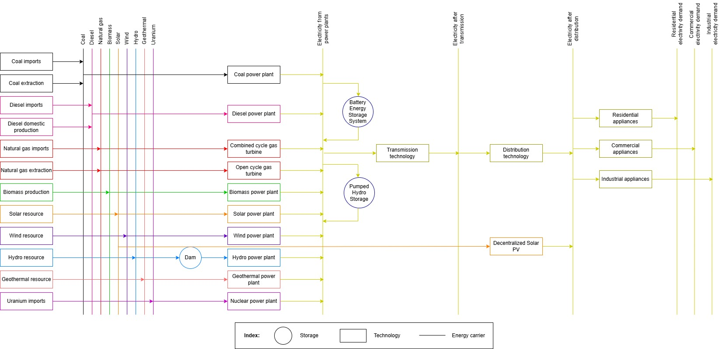
8.3 On-Grid vs Off-Grid
8.3.1 Introducing Off-Grid Solutions
15
Notes:
So far all of the power generation technologies we have discussed have been on-grid technologies. These are technologies that are connected to the transmission grid and are typically sizeable power plants or renewable energy facilities that produce electricity which is then passed to the transmission grid before being distributed to customers via the distribution grid. These technologies are also known as centralized solutions. However, there is another type of power generation technology that we have not yet discussed. These are off-grid technologies, also known as decentralized solutions. These technologies are used to generate power close to the point of consumption. For example, this could be at someone's home or factory, with the power then passed straight to the building rather than going through the transmission and distribution grids. Since decentralized technologies produce electricity that is immediately available to meet demand, rather than needing to be transmitted and distributed, these technologies are positioned further to the right in Reference Energy Systems, with their output fuel being electricity available to meet demand. The most commonly used decentralized solutions are decentralized solar PV technologies, highlighted on the Reference Energy System on this slide. We will look at these technologies in a little more detail next.

Slide 16
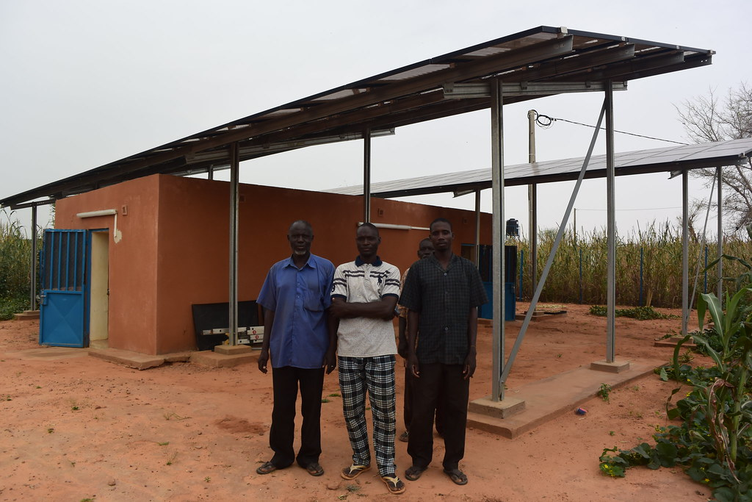

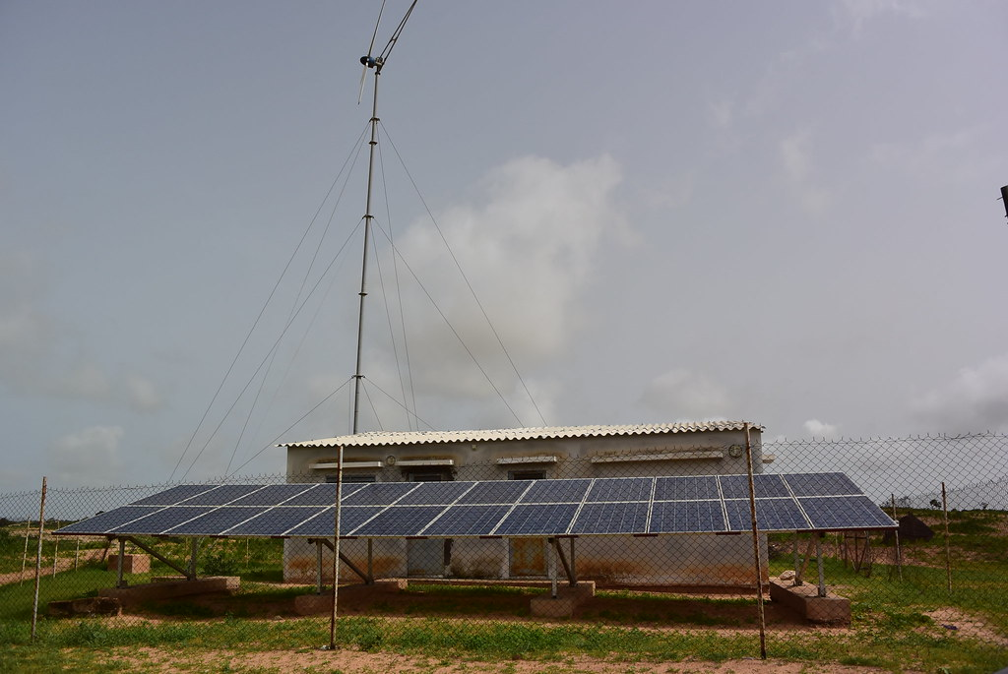
8.3 On-Grid vs Off-Grid
8.3.2 Overview of Off-Grid PV Technologies
(International Renewable Energy Agency, left, middle, right, license: CC BY-NC-ND 2.0)
16
Notes:
These photographs show example off-grid solar PV projects located in rural villages in Senegal. There are several different types of off-grid solar projects. These include mini-grids, where a set of solar panels is installed in a village or local community and used to generate electricity for local residents and businesses. In this case, local homes and businesses can all be connected to the electricity supply from the solar panel in a mini electricity grid. Secondly, there are individual solar home systems, in which an individual home can have its own solar panel(s) installed to power appliances such as lamps or mobile phone chargers. Additionally, there is also the option to have street lights or water pumps that are powered directly by their own solar panels. An example of a solar-powered street light is shown in the image on the far-right. If we think back to earlier in the lecture, we learnt that the amount of electricity generated by solar PV varies with the weather, as it is dependent on the strength of the sunshine. In order to allow consumers to have access to electricity even when it is dark, off-grid PV technologies can often be equipped with batteries. This means that excess electricity generated by PV panels when it is sunny can be stored in the battery for use when it is dark. This can bring significant benefits to local communities, allowing rural villages to be lit during the night. We will talk more about the role of off-grid technologies in the next slide. Before we move on, it is important to note that it is also possible to have other off-grid technologies, such as off-grid hydropower or wind power operated in mini-grids. However, we have focused on solar PV technologies since these are the most common.

Slide 17
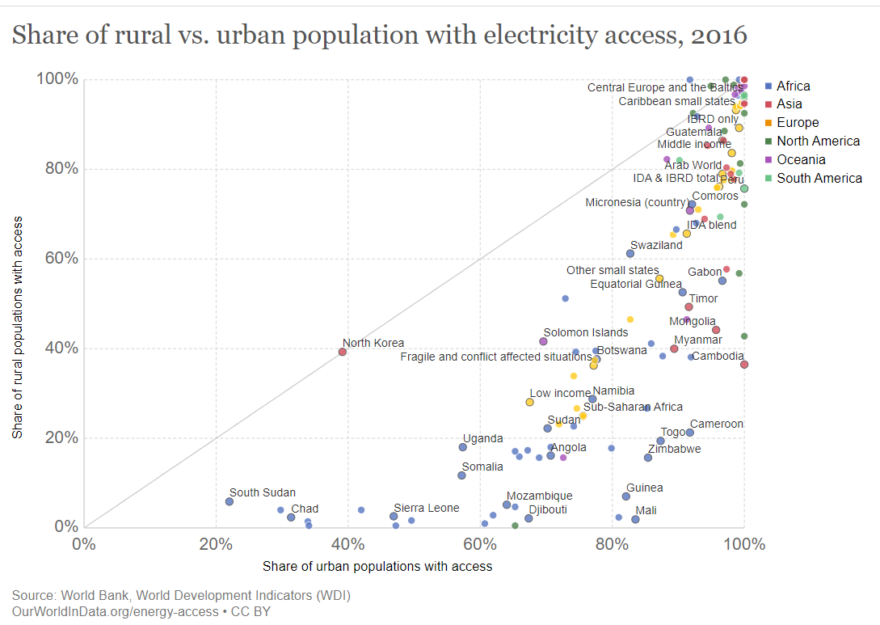
8.3 On-Grid vs Off-Grid
8.3.3 Role of Off-Grid Technologies
(Our World in Data, image,license: CC BY 3.0)
17
Notes:
Off-grid technologies have the potential to bring many benefits to energy systems. As seen in this diagram, it is common for electricity access rates to be much higher in urban areas than in rural areas. Low rates of electricity access in rural villages can restrict quality of life and progress towards multiple SDGs. However, extending the transmission and distribution networks to rural and remote areas is often logistically challenging and expensive, creating a barrier to progress. This is where off-grid solutions can be important as they can provide rural electricity access without the challenges of extending national electricity grids. Off-grid PV technologies like those shown on the previous slide can help to bring many benefits to local communities, including increased safety, new opportunities for education and business, and improved healthcare provision. In addition, solar-powered water pumps could have an important role in the agricultural economies of many countries. It is important to think about the electricity system as a whole: while centralized power generation may be more cost-effective where transmission networks are already established, off-grid solutions could play a key role in areas without these networks. They could also allow domestic renewable energy resources to be exploited, potentially also reducing reliance on polluting diesel generators and increasing energy security. The costs of off-grid technologies are falling, meaning their deployment could grow rapidly in the future.

Slide 18
8.3 On-Grid vs Off-Grid
8.3.4 Off-Grid Technologies in OSeMOSYS Pt1
Example decentralized solar PV data for key OSeMOSYS parameters:
Capacity Factor: varies by country
Capital Cost: $2840/kW
Fixed Cost: $28/kW
Operational Life: 20 years
(Data source: Pappis et al. (2019) Energy Projections for African Countries)
18
Notes:
This slide shows some example data for some key OSeMOSYS parameters for decentralized solar PV technologies. We can see that the capacity factor varies by country, and it will also vary by time slice due to variations in solar intensity, as was the case with centralized PV technologies. The capacity factor can also vary within a country as the solar intensity varies by location. Moving to costs, these example cost data suggest that decentralized PV technologies are slightly more expensive than centralized PV technologies. However, it is important to consider whole system costs, since the use of decentralized technologies reduces the investment needed to expand and maintain transmission and distribution networks. OSeMOSYS can help us to assess these whole system costs, as it calculates the optimal cost solution for the whole system. As a result, we can assess which combinations of technologies might be most cost-effective. Finally, the operational life is estimated at 20 years. In the next slide we will look further at representing off-grid PV technologies in OSeMOSYS and Reference Energy Systems.

Slide 19
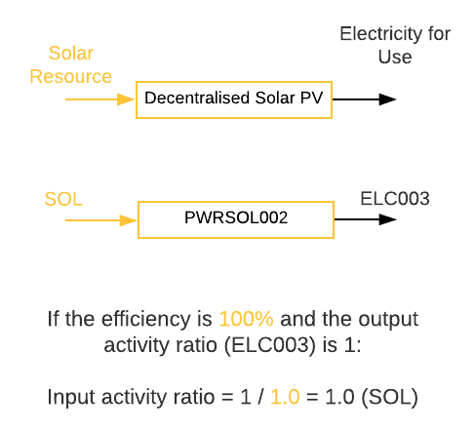
8.3 On-Grid vs Off-Grid
8.3.5 Off-Grid Technologies in OSeMOSYS Pt2
19
Notes:
On this slide we can take a closer look at how decentralized PV technologies are represented in Reference Energy Systems and OSeMOSYS. They are modelled as technologies with the input fuel being the solar resource and the output fuel being electricity for use. This is an important difference compared to centralized technologies, where the output fuel is electricity from power plants which is passed to the transmission network. We can then see the code names used. Notice that we can distinguish between different types of solar technologies using the number at the end of the technology code name: we often name centralized PV power plants as P.W.R.S.O.L. 0 0 1, while decentralized PV is named P.W.R.S.O.L. 0 0 2. We can also model multiple different decentralized PV options, such as PV mini-grids and residential rooftop PV, as separate technologies with different numbers at the end of the code name. This can be useful as cost and performance parameters may vary between different decentralized options. Finally, as we have done previously in the lecture for centralized PV and wind, let's calculate an example input activity ratio for decentralized PV, assuming the output activity ratio is set to 1. Remember that the output activity ratio for decentralized PV will be assigned to E.L.C. 0 0 3, rather than E.L.C. 0 0 1. This is because electricity is provided straight to consumers, not to the transmission grid. We can now determine the input activity ratio by calculating 1 over the efficiency as a decimal, giving an input activity ratio of 1. This is assigned to S.O.L. since this is the input fuel. We will practise modelling these technologies in hands on-exercises.

Slide 20
Lecture 8.3 References
Pappis, I., Howells, M., Sridharan, V., Usher, W., Shivakumar, A., Gardumi, F. and Ramos, E., Energy projections for African countries, Hidalgo Gonzalez, I., Medarac, H., Gonzalez Sanchez, M. and Kougias, I., editor(s), EUR 29904 EN, Publications Office of the European Union, Luxembourg, 2019, ISBN 978-92-76-12391-0, doi:10.2760/678700, JRC118432.
20

Slide 21
Thank you
Consolidated by:
Fernando Plazas-Niño, Kane Alexander, Elias Islam, Lucy Allington, Carla Cannone, Pooya Hoseinpoori, Alexander Kell, Adam Hawkes, Mark Howells
www.climatecompatiblegrowth.com

